Slide 1
React native

Slide 2




Slide 3
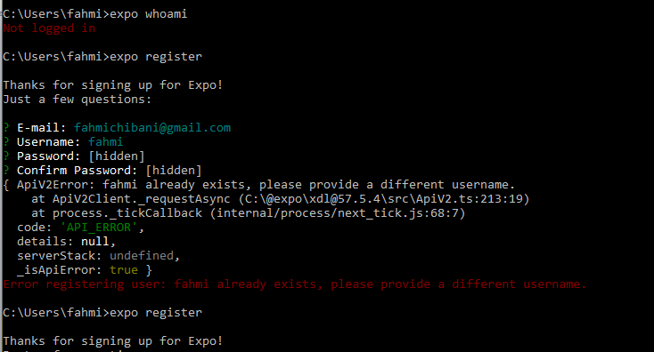


Slide 4
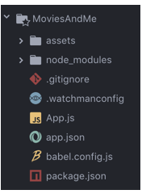




New project

Slide 5
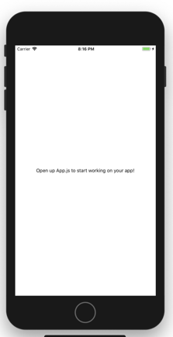

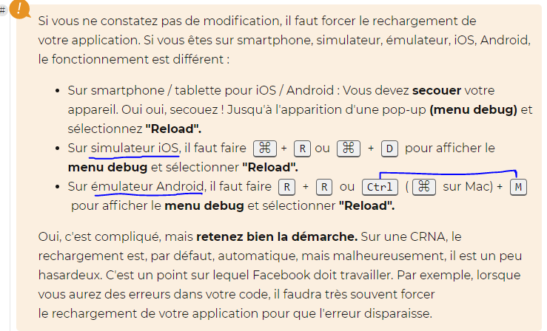
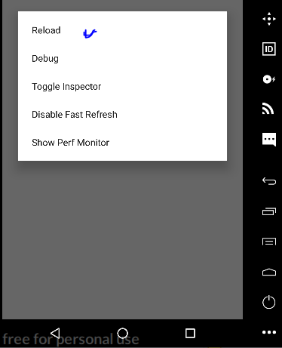

Slide 6
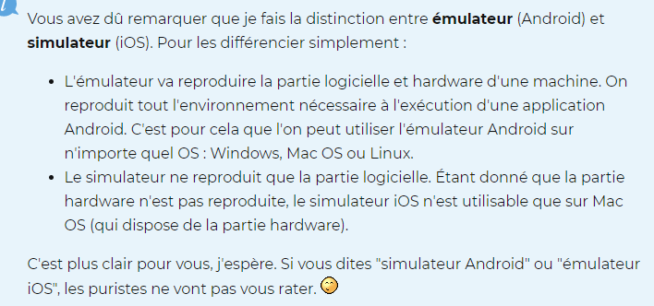

Slide 7



https://hackernoon.com/understanding-react-native-bridge-concept-e9526066ddb8

Slide 8

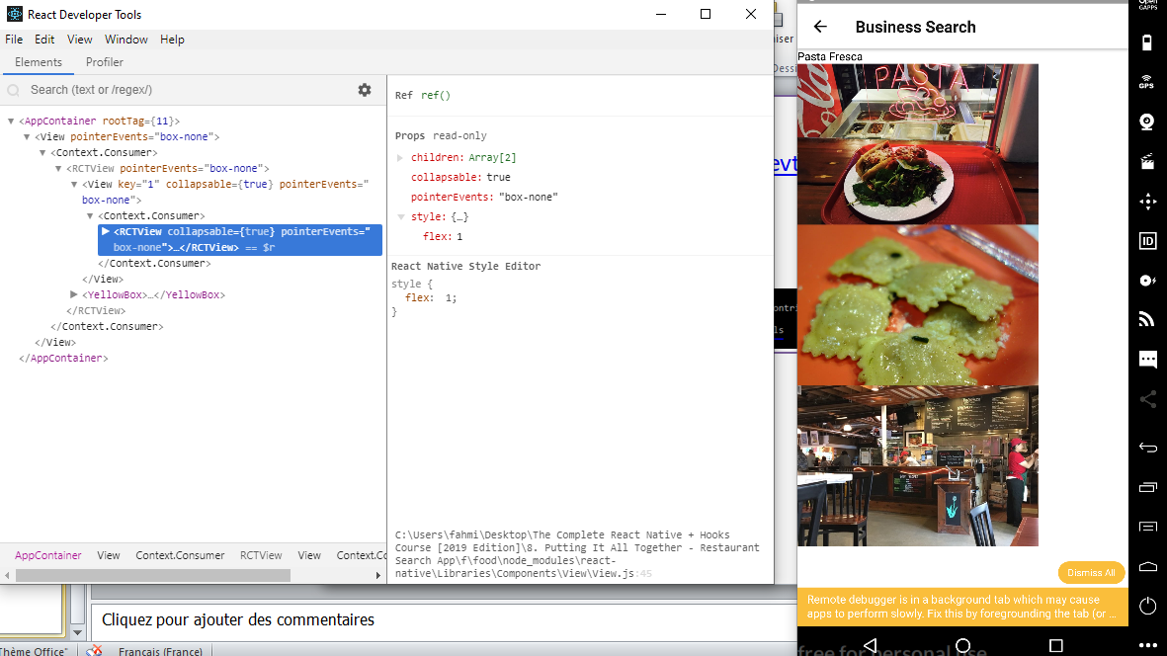
React devtools:
https://www.npmjs.com/package/react-devtools
Installation:
npm install -g react-devtools
Run:
C:\Users\fahmi> react-devtools

Slide 9

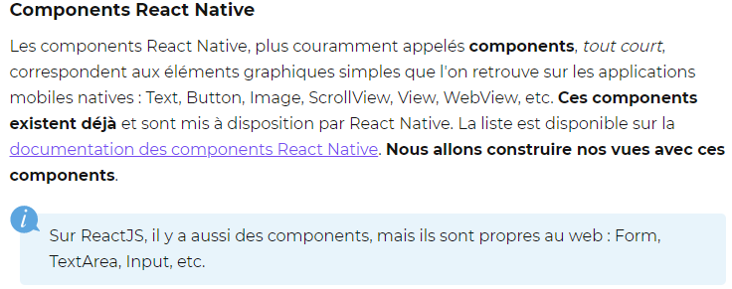


Slide 10
React devtools:
https://www.npmjs.com/package/react-devtools
Installation:
npm install -g react-devtools
Run:
C:\Users\fahmi> react-devtools

Slide 11


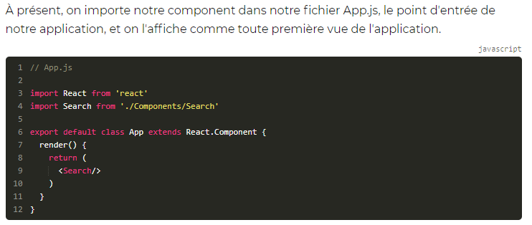
Create components

Slide 12

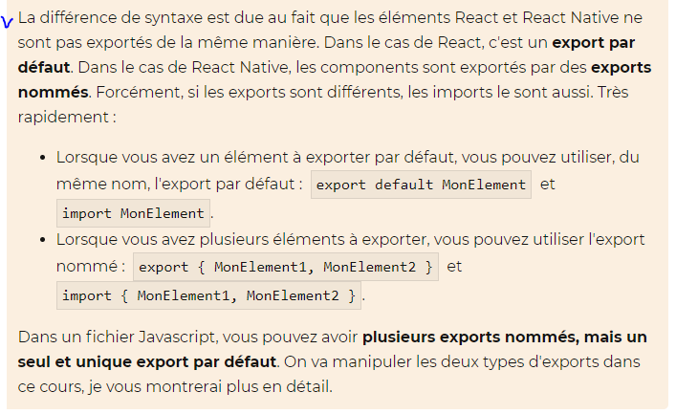

Slide 13
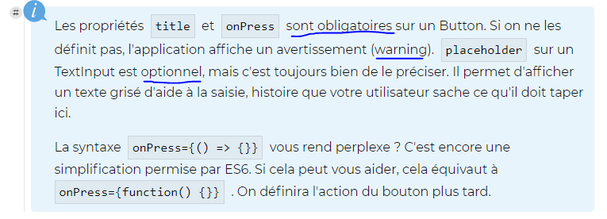


Slide 14
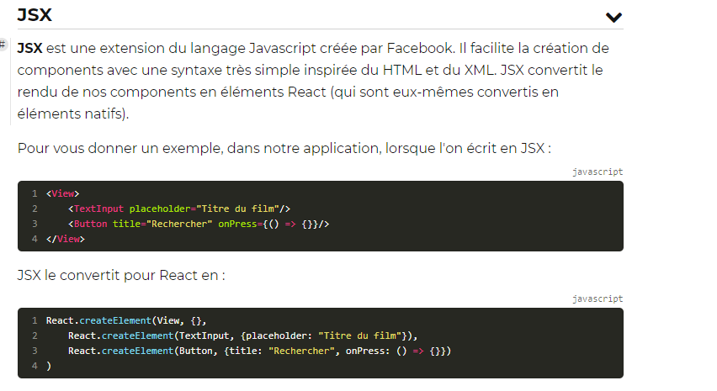


Slide 15

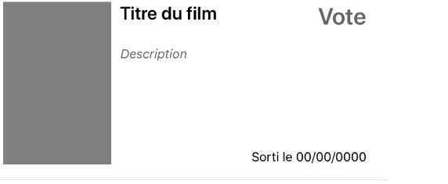
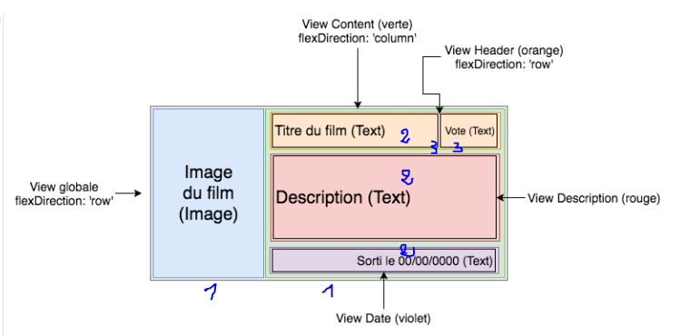

Slide 16




Slide 17



Fetch et api
https://reactnative.dev/docs/network.html#using-fetch

Slide 18
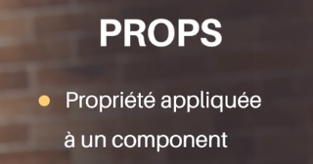
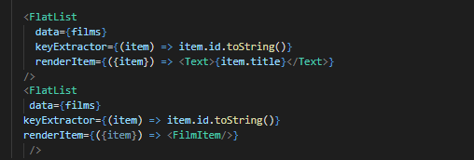


Slide 19



https://openclassrooms.com/en/courses/4902061-developpez-une-application-mobile-react-native/4915721-manipulez-le-state

Slide 20
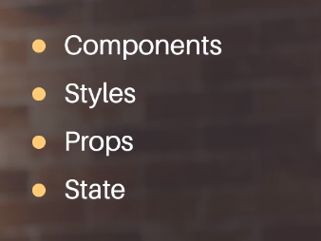
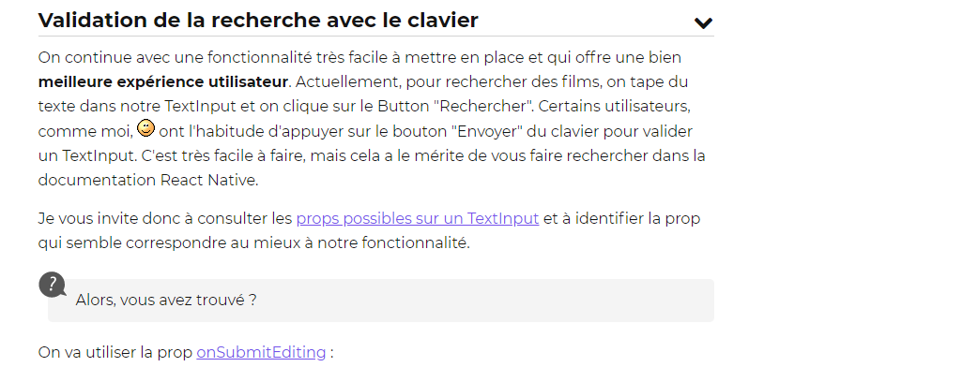

Slide 21
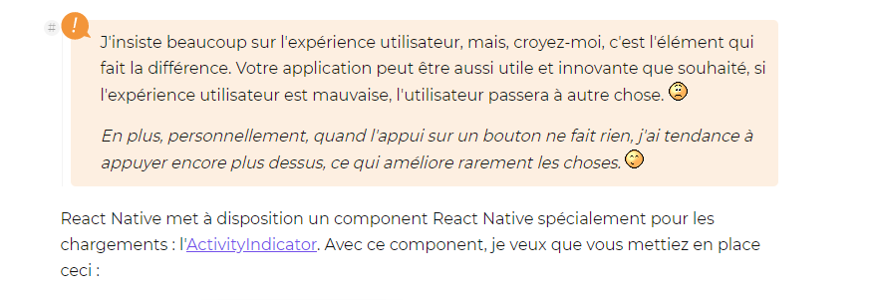

Slide 22



navigation

Slide 23
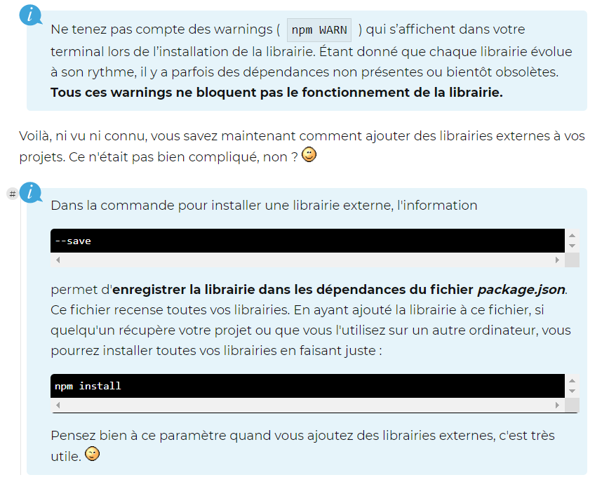

Slide 24


Slide 25
Cycle de vie

